Slide 1
MAPPING RELATIONAL TO OBJECT MODELS

Slide 2
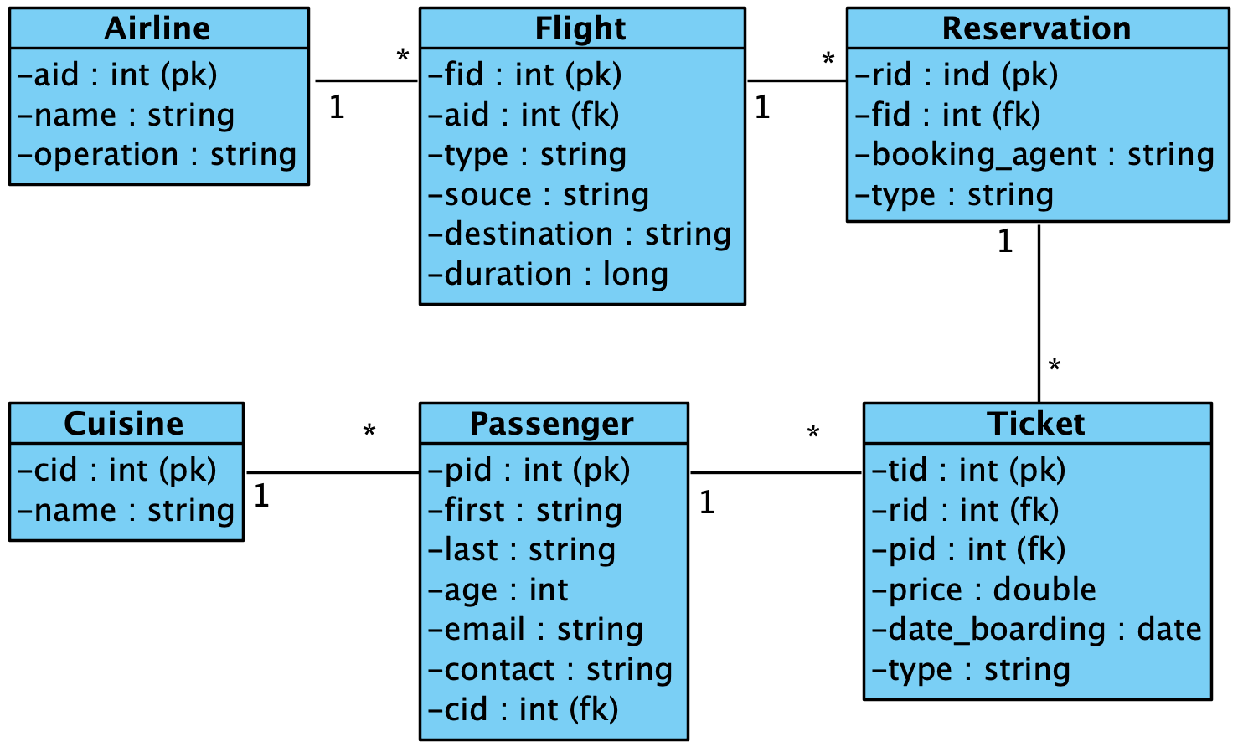
Consider the following database

Slide 3
How can we answer the following?
Which reservation(s) of flight(s) going to New York have a total cost of $400 or more, where the total cost of a reservation is the sum of the prices of all the tickets in that reservation?

Slide 4
RELATIONAL DATA MODELS

Slide 5
Let's Create a Database

Slide 6
First let's create the airlines table

Slide 7
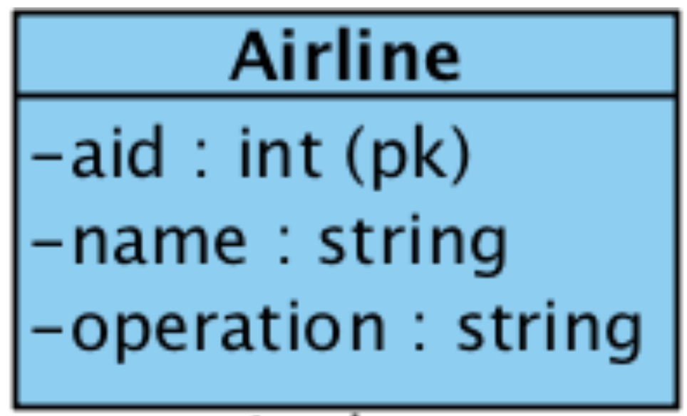
airlines Table
CREATE TABLE `airlines` (
`aid` int(11) NOT NULL AUTO_INCREMENT,
`name` varchar(45) DEFAULT NULL,
`operation` varchar(45) DEFAULT NULL,
PRIMARY KEY (`aid`)
);

Slide 8
Insert Airlines
INSERT INTO `airlines` VALUES (1,'JetBlue','OP1');
INSERT INTO `airlines` VALUES (2,'Delta','OP2');
INSERT INTO `airlines` VALUES (3,'American','OP3');
INSERT INTO `airlines` VALUES (4,'United','OP4');

Slide 9
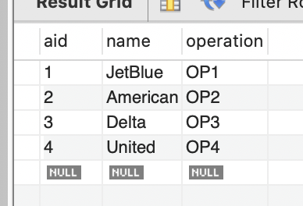
airlines Table

Slide 10
Now let's create the flights table

Slide 11
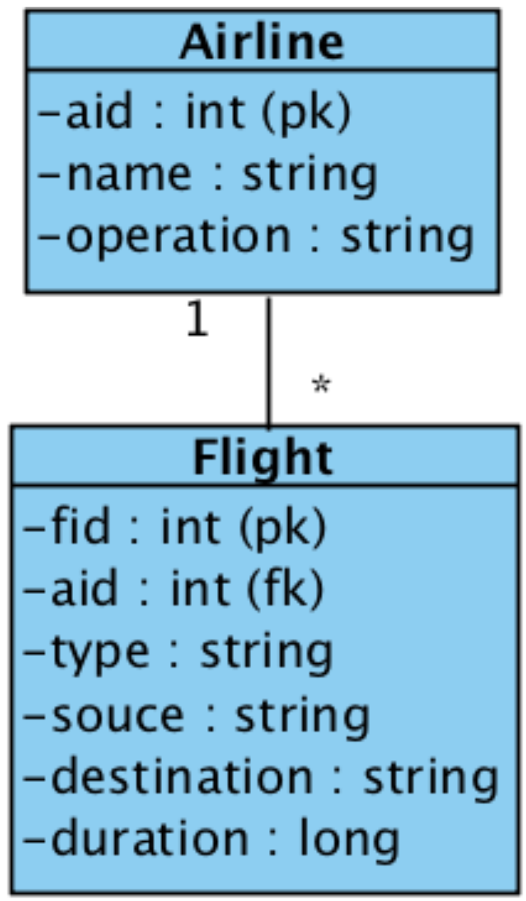
flights Table references airlines
CREATE TABLE `flights` (
`fid` int(11) NOT NULL AUTO_INCREMENT,
`aid` int(11) DEFAULT NULL,
`type` varchar(45) DEFAULT NULL,
`source` varchar(45) DEFAULT NULL,
`destination` varchar(45) DEFAULT NULL,
`duration` float DEFAULT NULL,
PRIMARY KEY (`fid`),
CONSTRAINT `f2a` FOREIGN KEY (`aid`)
REFERENCES `airline` (`aid`)
);

Slide 12
Insert Flights
INSERT INTO `flights` VALUES
(1, 1 ,'T1','S1','NY',123),
(2, 1 ,'T2','S2','NY',234),
(3, 2 ,'T3','S3','NY',345),
(4, 2 ,'T4','S4','NY',456), (5, 2 ,'T5','S5','NY',567),
(6, 3 ,'T6','S6','DC',678),
(7, 3 ,'T7','S7','LA',789);

Slide 13
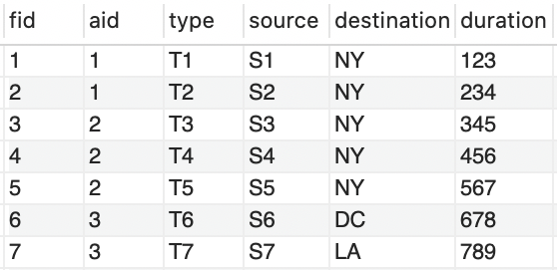
airlines 1 －－ * flights

Slide 14
Now let's create the reservations table

Slide 15
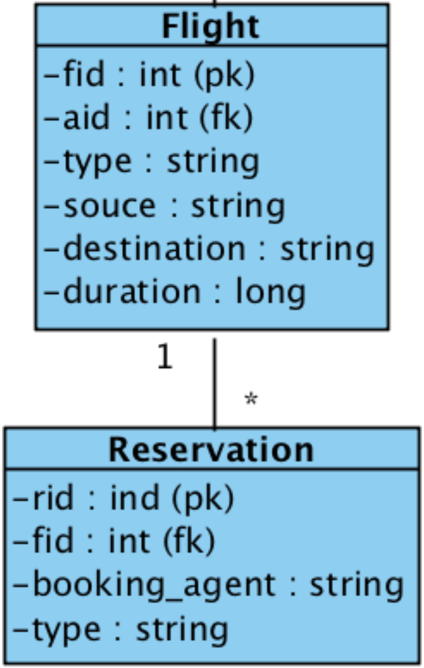
reservations Table
CREATE TABLE `reservations` (
`rid` int(11) NOT NULL AUTO_INCREMENT,
`fid` int(11) DEFAULT NULL,
`booking_agent` varchar(45) DEFAULT NULL,
`type` varchar(45) DEFAULT NULL,
PRIMARY KEY (`rid`),
CONSTRAINT `r2f` FOREIGN KEY (`fid`)
REFERENCES `flight` (`fid`)
);

Slide 16
Insert reservations
INSERT INTO `reservations` VALUES (1, 1 ,'BA1','T1'),
(2, 1 ,'BA2','T2'),
(3, 1 ,'BA3','T3'),
(4, 2 ,'BA4','T4'),
(5, 2 ,'BA5','T5');

Slide 17
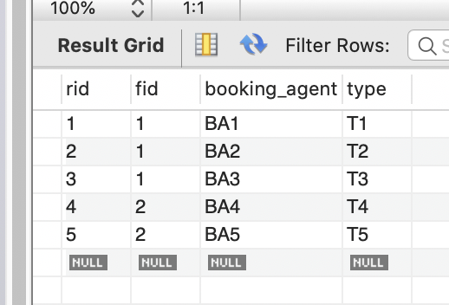
reservations
flights

Slide 18
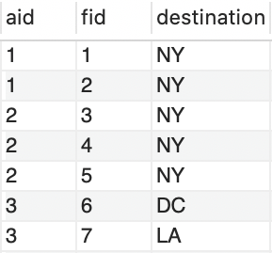
airlines flights reservations

Slide 19
Create cuisine and passengers table

Slide 20
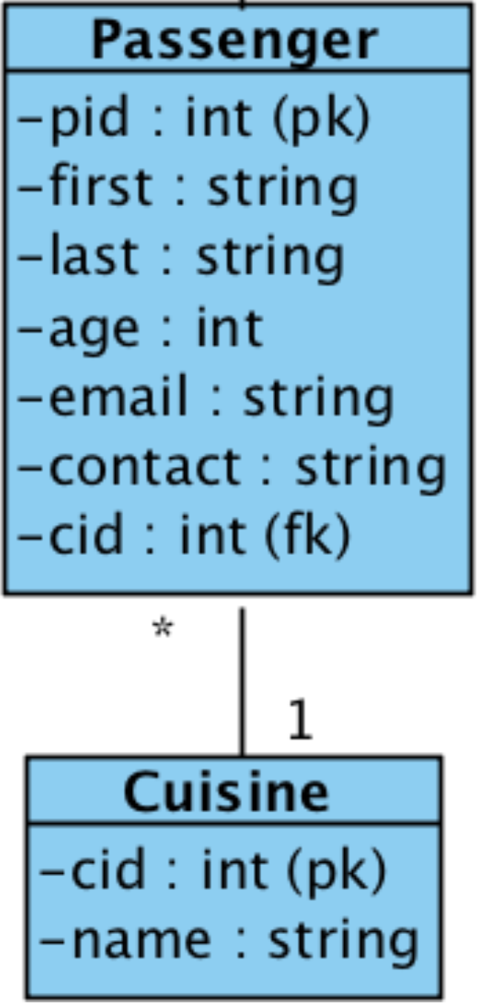
cuisines Table
CREATE TABLE `cuisines` (
`cid` int(11) NOT NULL AUTO_INCREMENT,
`name` varchar(45) DEFAULT NULL,
PRIMARY KEY (`cid`)
);

Slide 21
Insert Cuisines
INSERT INTO `cuisines` VALUES
( 1 ,'Chicken Broccoli'),
( 2 ,'Macaroni and Cheese'),
( 3 ,'Risotto'),
( 4 ,'Spaghetti alla Carbonara'),
( 5 ,'Puttanesca'),
( 6 ,'Arroz con Gandules');

Slide 22
passengers Table
CREATE TABLE `passengers` (
`pid` int(11) NOT NULL AUTO_INCREMENT,
`first` varchar(45) DEFAULT NULL,
`last` varchar(45) DEFAULT NULL,
`age` int(11) DEFAULT NULL,
`email` varchar(45) DEFAULT NULL,
`contact` varchar(45) DEFAULT NULL,
`cid` int(11) DEFAULT NULL,
PRIMARY KEY (`pid`),
CONSTRAINT `p2c` FOREIGN KEY (`cid`)
REFERENCES `cuisine` (`cid`)
);

Slide 23
Insert Passengers
INSERT INTO `passengers` VALUES
(1,'Alice','Wonderland',23,'aw@gmail.com','Bob', 1 ),
(2,'Bob','Marley',34,'bm@gmail.com','Alice', 2 ),
(3,'Charley','Garcia',45,'cg@gmail.com','Alice', 3 );

Slide 24
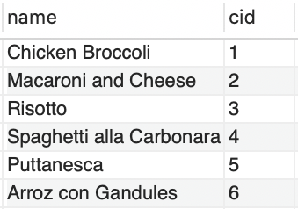
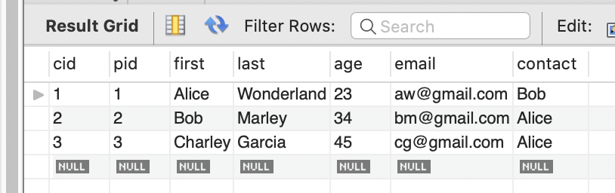
cuisines persons

Slide 25
Now let's create many to many tickets table

Slide 26
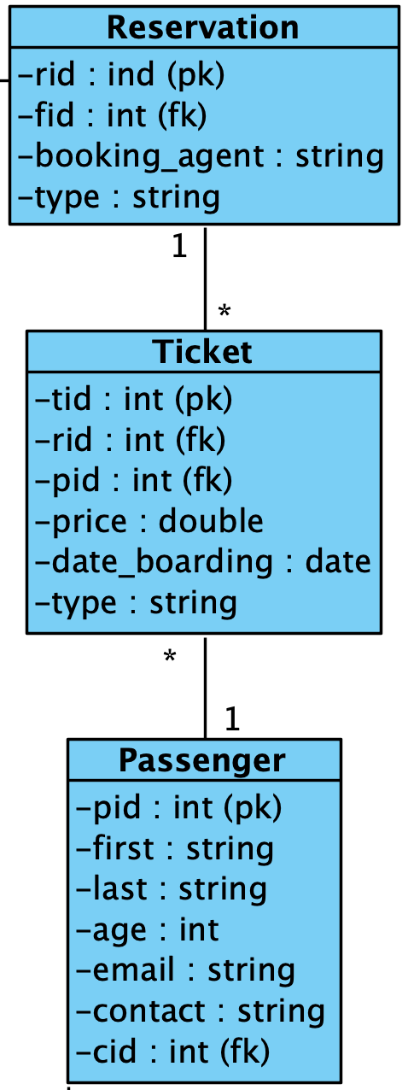
tickets Table
CREATE TABLE `tickets` (
`tid` int(11) NOT NULL AUTO_INCREMENT,
`rid` int(11) DEFAULT NULL,
`pid` int(11) DEFAULT NULL,
`price` float DEFAULT NULL,
`date_boarding` datetime DEFAULT NULL,
`type` varchar(45) DEFAULT NULL,
PRIMARY KEY (`tid`),
CONSTRAINT `t2r` FOREIGN KEY (`rid`)
REFERENCES `reservation` (`rid`)
CONSTRAINT `t2p` FOREIGN KEY (`pid`)
REFERENCES `passenger` (`pid`),
);

Slide 27
Insert tickets
INSERT INTO `tickets` VALUES
(1, 1 , 1 ,123,'2020-10-12 00:00:00','T1'),
(2, 1 , 2 ,234,'2020-10-22 00:00:00','T2'),
(3, 2 , 2 ,234,'2020-11-23 00:00:00','T2'),
(4, 2 , 2 ,345,'2020-11-23 00:00:00','T2'),
(5, 2 , 2 ,456,'2020-11-21 00:00:00','T1'),
(6, 3 , 3 ,556,'2020-12-2 00:00:00','T1');

Slide 28
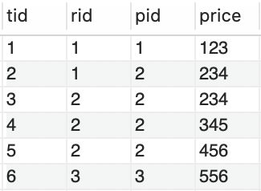
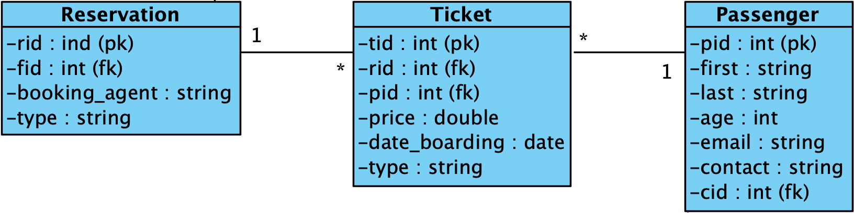
reservations tickets passengers

Slide 29
COMPLEX QUERIES

Slide 30
Consider
Which reservation(s) of flight(s) going to New York have a total cost of $400 or more, where the total cost of a reservation is the sum of the prices of all the tickets in that reservation?

Slide 31
Let's find flights to New York
Which reservation(s) of flight(s) going to New York have a total cost of $400 or more, where the total cost of a reservation is the sum of the prices of all the tickets in that reservation?

Slide 32
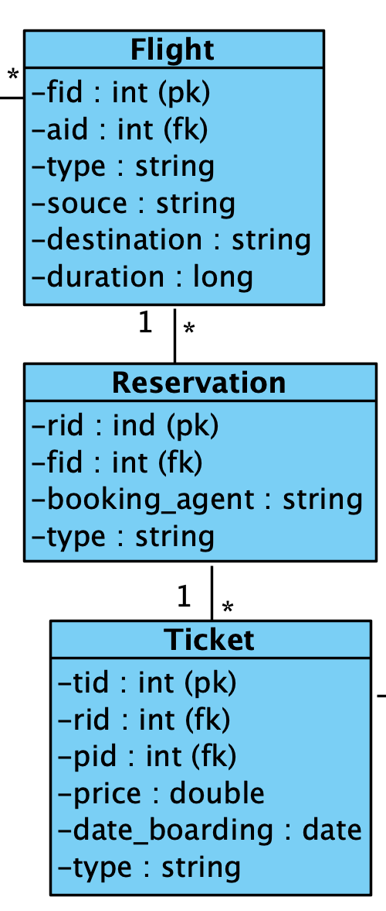
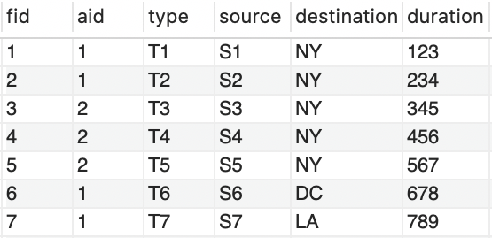
All Flights
select *
from flights f;
flights

Slide 33
Flights to NY
select *
from flights f
where
f.destination=''NY'';
select: destination='NY'
flights

Slide 34
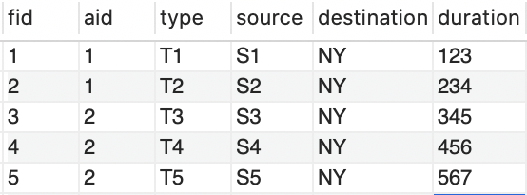
Flights to NY
select *
from flights f
where f.destination=''NY'';
⨉
⨉

Slide 35
Let's find reservations to New York
Which reservation(s) of flight(s) going to New York have a total cost of $400 or more, where the total cost of a reservation is the sum of the prices of all the tickets in that reservation

Slide 36
Reservations to NY
select *
from flight f, reservation r
where f.destination='NY'
and f.fid=r.fid;

Slide 37
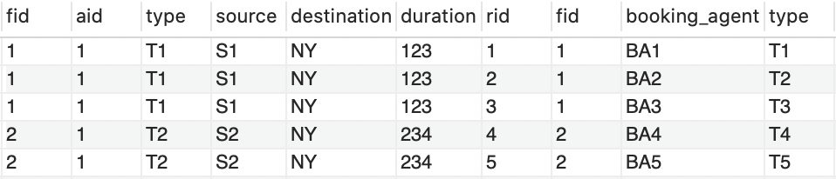
select: destination='NY'
join: f.fid=r.fid
flights
reservations

Slide 38
Reservations to NY
select f.destination, r.rid
from flight f, reservation r
where f.destination='NY'
and f.fid=r.fid;

Slide 39
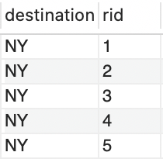
project: f.destination, r.rid
select: destination='NY'
join: f.fid=r.fid
flights
reservations

Slide 40
Prices of Flights to NY
Which reservation(s) of flight(s) going to New York have a total cost of $400 or more, where the total cost of a reservation is the sum of the prices of all the tickets in that reservation

Slide 41
Prices of Flights to NY
select f.destination, r.rid, t.price
from flights f, reservations r, tickets t
where f.destination='NY'
and f.fid=r.fid
and r.rid=t.rid;

Slide 42
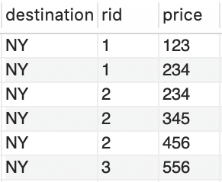
project: f.destination, r.rid, t.price
select: destination='NY'
join: f.fid=r.fid
join: f.fid=r.fid
flights
reservations
tickets

Slide 43
Prices of Flights to NY Per Reservation
Which reservation(s) of flight(s) going to New York have a total cost of $400 or more, where the total cost of a reservation is the sum of the prices of all the tickets in that reservation

Slide 44
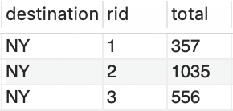
Prices of Flights to NY Per Reservation
select f.destination, r.rid, sum(t.price) as total
from flights f, reservations r, tickets t
where f.destination='NY'
and f.fid=r.fid
and r.rid=t.rid
group by r.rid;

Slide 45
group by r.rid, sum(t.price) as total
sum(t.price) as total
group by r.rid;

Slide 46
project: f.destination, r.rid, total
group by: {r.rid}, {sum(price)}
select: destination='NY'
join: f.fid=r.fid
join: f.fid=r.fid
flights
reservations
tickets

Slide 47
Reservation with Total Costs > 400
Which reservation(s) of flight(s) going to New York have a total cost of $400 or more, where the total cost of a reservation is the sum of the prices of all the tickets in that reservation

Slide 48
Reservation with Total Costs > 400
select r.rid
from reservations r,
( select f.destination, r.rid, sum(t.price) as total
from flights f, reservations r, tickets t
where f.destination='NY'
and f.fid=r.fid and r.rid=t.rid
group by r.rid ) as `totalNY`
where r.rid = totalNY.rid
and totalNY.total > 400

Slide 49
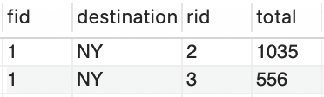
project: fid, destination, rid, total
select: total=400
join: r.rid = totalNY.rid
reservations
totalNY

Slide 50
How about this one?
How many reservations were made with the JetBlue flights for a cost higher than the average cost of all JetBlue's reservations? Note that the cost of a reservation is the sum of the price of all tickets in that reservation. Only list the total number of reservations. Rename the calculated field NumReservationsGTAvgForJB.

Slide 51
OBJECT DATA MODELS

Slide 52
Views as abstractions
Useful queries can be named to be reused as if they were tables
Views can play same role as functions in programming languages: they abstract/hide complexity behind identifiers
Applications
Databases
functions
views
algorithms
queries

Slide 53
Create View
CREATE VIEW `reservationsWithTotalCostsGt400` AS
select totalNY.fid, totalNY.destination, r.rid, totalNY.total
from reservation r,
(select f.fid, f.destination, r.rid, sum(t.price) as total
from flight f, reservation r, ticket_info t
where f.destination='NY'
and f.fid=r.fid
and r.rid=t.rid
group by r.rid) as `totalNY`
where r.rid = totalNY.rid
and totalNY.total > 400

Slide 54
Use views like a table
SELECT * FROM
airline.reservationsWithTotalCostsGt400;

Slide 55
Mapping Relational to Object Models
Applications map relational models to object data models
Data access logic query data from databases and map resulting rows to in-memory object instances
Application
Database
Data Model
Data
Access
Tables
Classes/ Objects
Rows

Slide 56
Let's implement a Object Data Model
package jdbc.models;
public class ReservationLessThan400 {
private Integer flightId;
private String destination;
private String reservationId;
private Float total;
}

Slide 57
Setters & Getters
public Integer getFlightId() { … }
public void setFlightId(Integer flightId) { … }
public String getDestination() { … }
public void setDestination(String destination) { … }
public String getReservationId() { … }
public void setReservationId(String reservationId) { … }
public Float getTotal() { … }
public void setTotal(Float total) { … }

Slide 58
Constructors
public ReservationLessThan400(Integer flightId, String destination, String reservationId, Float total) {
this.flightId = flightId;
this.destination = destination;
this.reservationId = reservationId;
this.total = total;
}
public ReservationLessThan400() { }

Slide 59
DATA ACCESS OBJECTS (DAOS)

Slide 60
Data Access Objects
Data Access Objects (DAOs) is a design pattern that encourages encapsulating data access logic
DAOs provide API to CRUD data
Application
Database
Data Model
DAOs
Tables
Classes/ Objects
Rows

Slide 61
ReservationsReportDao.java
package jdbc.daos;
import jdbc.models.ReservationLessThan400;
import java.sql.*;
import java.util.ArrayList;
import java.util.List;
public class ReservationsReportDao { … }

Slide 62
getConnection()
public static Connection getConnection() {
if(connection != null) { return connection; }
try {
Class.forName(JDBC_DRIVER);
connection = DriverManager.getConnection(DB_URL, USER, PASS);
} catch (ClassNotFoundException | SQLException e) {
e.printStackTrace();
}
return connection;
}

Slide 63
Configure JDBC Connection
static final String JDBC_DRIVER = "com.mysql.cj.jdbc.Driver";
static final String HOST = "localhost:3306";
static final String SCHEMA = "A3";
static final String CONFIG = "serverTimezone=UTC";
static final String DB_URL
= "jdbc:mysql://"+HOST+"/"+SCHEMA+"?"+CONFIG;
static final String USER = "a3";
static final String PASS = "a3";
static Connection connection = null;
static PreparedStatement statement = null;

Slide 64
findAllReservationsLessThan400()
private static String FIND_ALL_RESERVATIONS
= "SELECT * FROM airline.reservationwithtotalcostsgt400;";
public List<ReservationLessThan400> findAllReservationsLessThan400() {
List<ReservationLessThan400> reservations
= new ArrayList<ReservationLessThan400>();
connection = getConnection();
try {
statement = connection.prepareStatement(FIND_ALL_RESERVATIONS);
// … next slide ...
} catch (SQLException e) { e.printStackTrace();}
return reservations;
}

Slide 65
resultSet
ResultSet resultSet = statement.executeQuery();
while (resultSet.next()) {
Integer fid = resultSet.getInt("fid");
String destination = resultSet.getString("destination");
Integer rid = resultSet.getInt("rid");
Float total = resultSet.getFloat("total");
ReservationLessThan400 reservation
= new ReservationLessThan400(fid, destination, rid, total);
reservations.add(reservation);
}

Slide 66
Using DAOs
public static void main(String[] args) {
ReservationsReportDao dao = new ReservationsReportDao();
List<ReservationLessThan400> reservations
= dao.findAllReservationsLessThan400();
for(ReservationLessThan400 reservation:reservations) {
System.out.println(reservation);
}
}

